Slide 1
Lecture 2
Fundamentals of object-oriented programming

Slide 2
OO Programming Concepts

Slide 3
Class and Objects

Slide 4
Class declaration
class Circle {
double radius = 1.0;
double findArea(){
return radius * radius * 3.14159;
}
}

Slide 5
Declaring Object Reference Variables
ClassName objectReference;
Example:
Circle myCircle;

Slide 6
Creating objects
objectReference = new ClassName();
Example:
myCircle = new Circle();
The object reference is assigned to the object reference variable.

Slide 7
DECLARING / CREATING OBJECTS
ClassName objectReference = new ClassName();
Example:
Circle myCircle = new Circle();

Slide 8
Differences between variables of primitive Data types and object types

Slide 9
Copying Variables of Primitive Data Types and Object Types

Slide 10
Modifiers Static vs. Instance Members
By default, members are per instance
  Each instance gets its own fields
  Methods apply to a specific instance
Static members are per type
  Static methods can’t access instance data
  No this variable in static methods

Slide 11
Static methods
Static methods are called by using the class name, not the instance of the class.
The Console class and its Read and Write methods are an example of static methods. The following code example calls Console.WriteLine and Console.ReadKey methods without creating an instance of the Console class.
class Program
{
public static void withoutObj()
{
Console.WriteLine("Hello");
}
static void Main()
{
Program. withoutObj();
Console.ReadKey();
}
}

Slide 12
Access modifiers
Access modifiers specify who can use a type or a member
Access modifiers control encapsulation
Class members can be public, private, protected, internal, or protected internal
Struct members can be public, private or internal

Slide 13
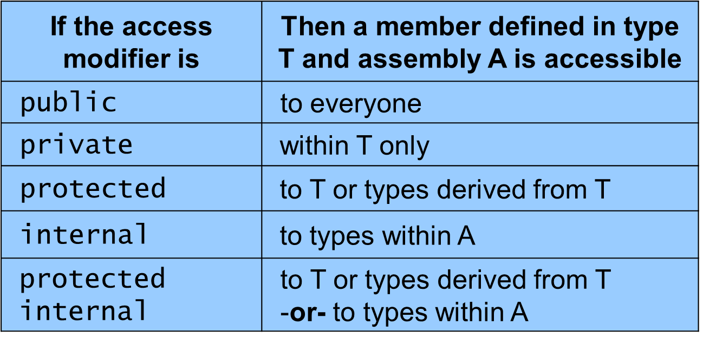
Access modifiers

Slide 14
Access defaults
You should always explicitly mark what access you want.
Class definitions default to internal.
Member fields, methods and events default to private for classes

